Slide 1
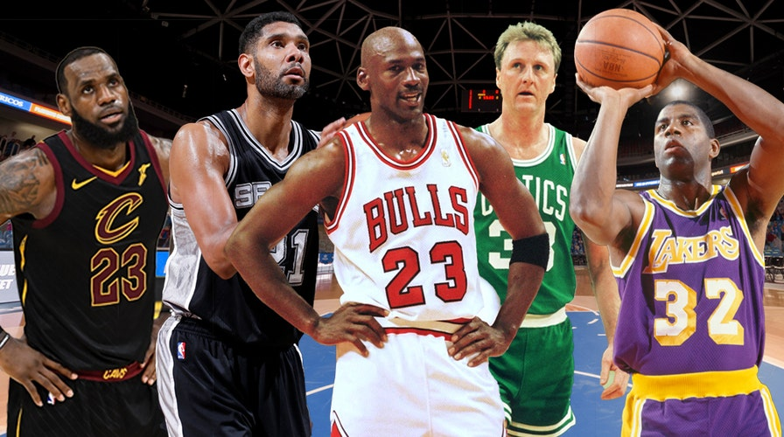
NBA: All Time Statistics and Performance
GROUP 1: https://github.com/Gmarisc2/BUS-5100.git
Ronaldo Villalobos
Vanessa Aguiar
Yousef Elbanna
Gustavo Mariscal
Ruben Tomasian
Juan Soto
Notes:
NBA Stattt

Slide 2

Abstract
Data and its URL/source:
“NBA All Time Stats- (1950- Present)“
https://www.kaggle.com/datasets/gonzalogigena/nba-all-time-stats
What we want to Analyze and Predict:
Data provides a variety of information from 1950-Present, offering a wealth of factual evidence and metrics for every NBA player and teams.
Why This Analysis and Prediction Matter:
NBA is the 2nd most popular sports in the US and commands 2.2 billion fans worldwide. Understanding trends and direction will help us make future predictions.
Notes:
Allows us to discern overarching trends within the NBA, including performance disparities across positions, team dynamics, shifts across eras, and the profound influence of specific players.
Data Size:
3MB
All-time greatest player based on individual performance, team performance and other statistical data
Provides insights into the future trajectory of the NBA
With a staggering fan base exceeding 2.2 billion individuals, it’s populatirty and influence across the globe can’t be understated

Slide 3
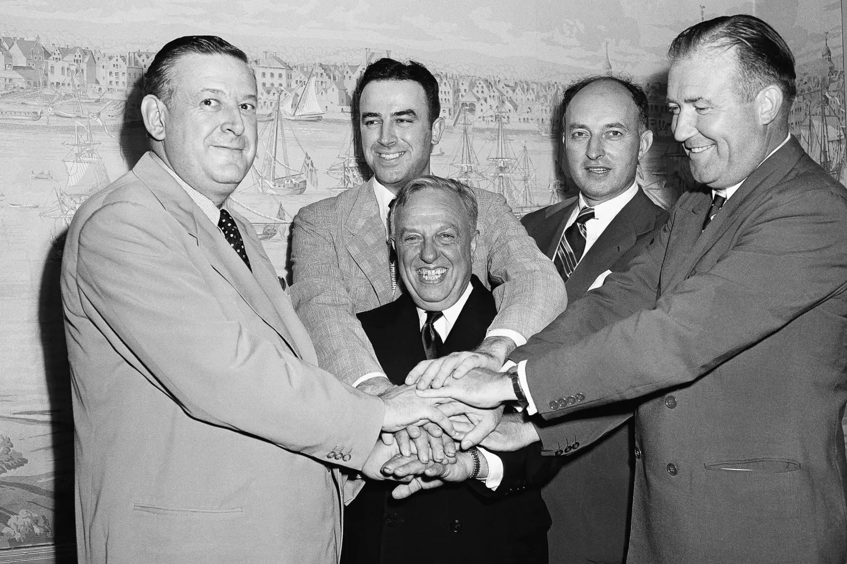
NBA History and Overview
The NBA was founded in 1946 by Walter Brown who aimed to create an indoor sport for the winter season.
Initially consisting with 11 teams, the NBA has expanded to 30 current teams across the US and Canada.
Today, the NBA is the 2nd most popular sports in the US and boasts the highest revenue in excess of $10 billion annually.
Notes:
Photo on the right when NBA, NBL, and BAA all merged into the current NBA

Slide 4
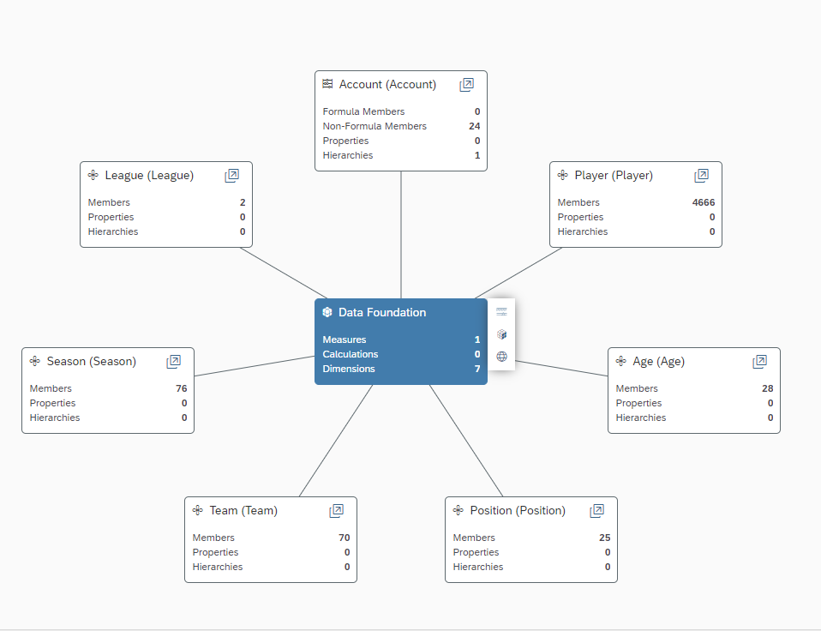
NBA player Dataset Model Structure
Notes:
Let's look into our first and primary dataset. This data encapsules all time statistics and performance across 6 dimensions, which include: Player, Age, Position, Team, Season, and League. Within this framework, we totaled 24 measures but are only spotlighting Rebounds, Assists, Steals, Total Points, and 2 & 3 point attempts.

Slide 5
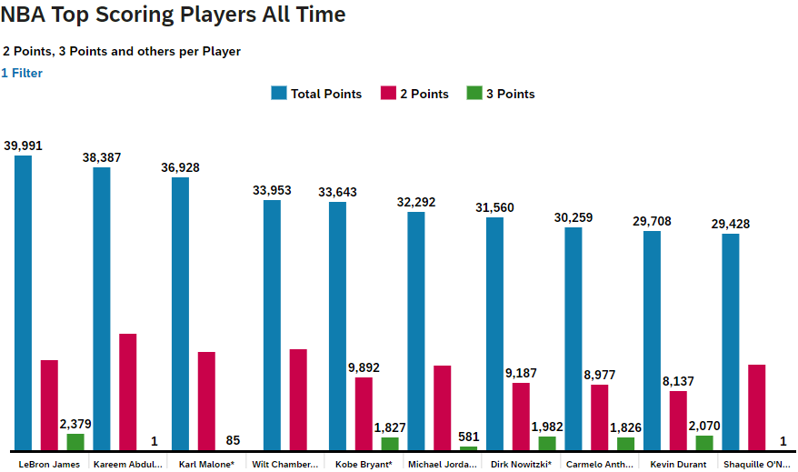
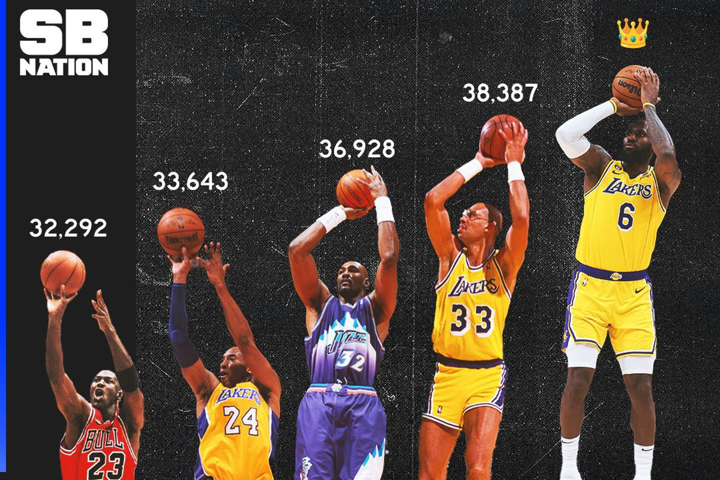
NBA Top Scoring Players All time
Points are credited to any player that makes a successful shot including 3pt, 2pt, and 1pt free throws.
Graph includes total points scored, 2pts, and 3pts
Notes:
In our assessment, points scored is the most important statistic and has a direct correlation with a team's winning record and overall success in the NBA. This graph showcases the top 10 all-time scores with totals for total points, 2 point, and 3 point scores. Notably, Lebron James emerges as the all-time leader in this category. And a funny thing to point out is among another famous career, Shaq only made a single three-point shot.

Slide 6
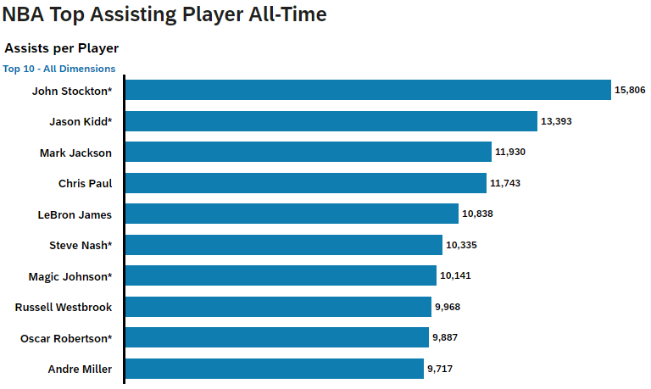
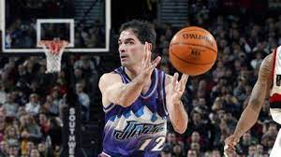
NBA Top Assists Players All time
Credited to a player that made the last pass before a scored field goal.
Entire lists consists of point gaurds, with the exception of Lebron James
Notes:
Assists are an equally important stat to measure as they also directly correlate to winning and success
Assists are creditd to a player that made the last pass before a scored field goal
What is interesting about the top 10 is that the entire list consists of point guards with the exception of Lebron who is a power forward

Slide 7
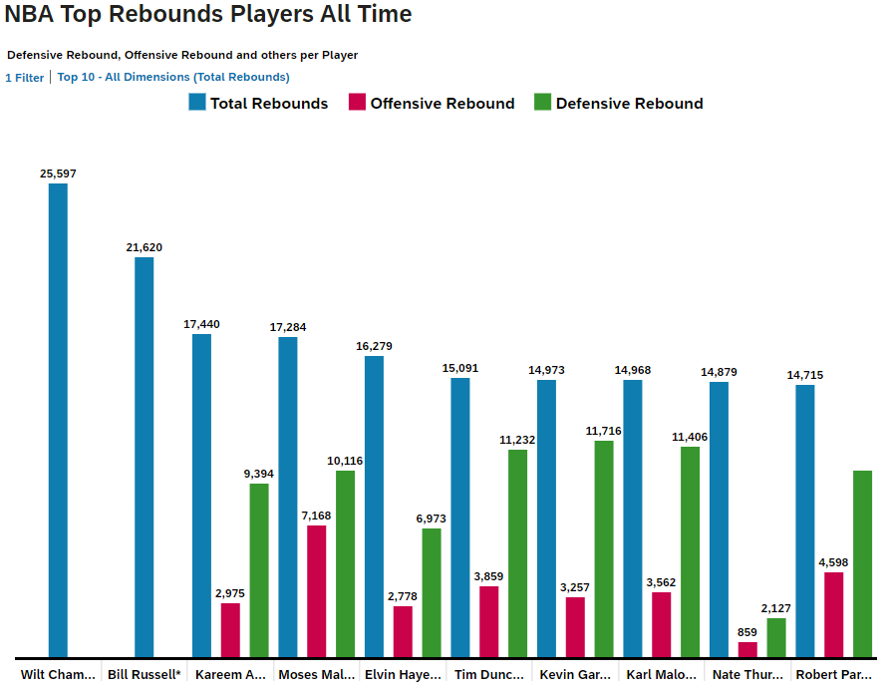
NBA Top Rebound Players All time
Credited to a player that gains possession of a ball after any missed shot
Offensive rebounds are typically much more difficult to obtain than defensive
Wilt Chamberlain and Bill Russel's stats were recorded before offensive/defensive were counted
Notes:
Rebounds are another important stat and an integral part of the game of basketball as it is a fast pace game and constantly changes possession
A Rebound is credited to a player that gains possession of a ball after any missed shot
Offensive rebounds are typically much more difficult to obtain than defensive. When someone does get an offensive rebound, it gives the offense another possession and opportunity to score
You may be wondering why the leaders (Wilt Chamberlain and Bill Russel) on this list do not have any offensive/defensive rebounds? This is because this stat only started being recorded in the 1973-1974 season

Slide 8
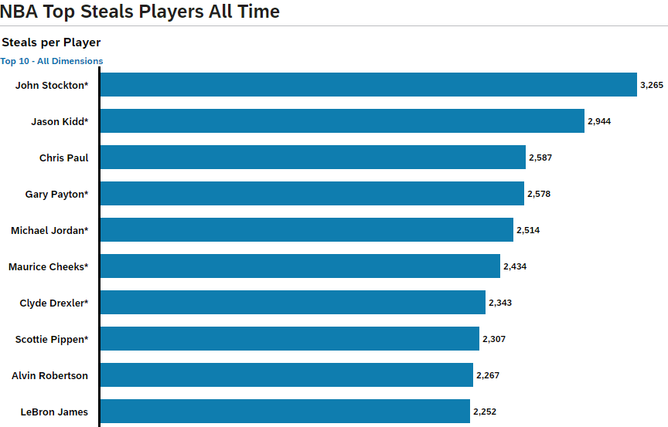
NBA Top Steals Players All time
Credited to a player that legally intercepts or takes away the ball from the opposing team.
Entire list consists of smaller and quicker gaurds, with the exception of Lebron James and Scottie Pippen who are forwards. This position typically does not lead in steals.
Notes:
Lastly, the final stat we’ll be measuring is steals. Steals are credited to a player that legally intercepts or takes away the ball from the opposing team.
The emphasis is on legally as the NBA tends to call lots of frivolous fouls, so those that can steal the ball successfully demonstrate a high level of skill
The entire list consists of smaller and quicker guards that do well in this stat with the exception of Lebron and Sottie Pippen who are taller forwards and typically do not lead in steals

Slide 9
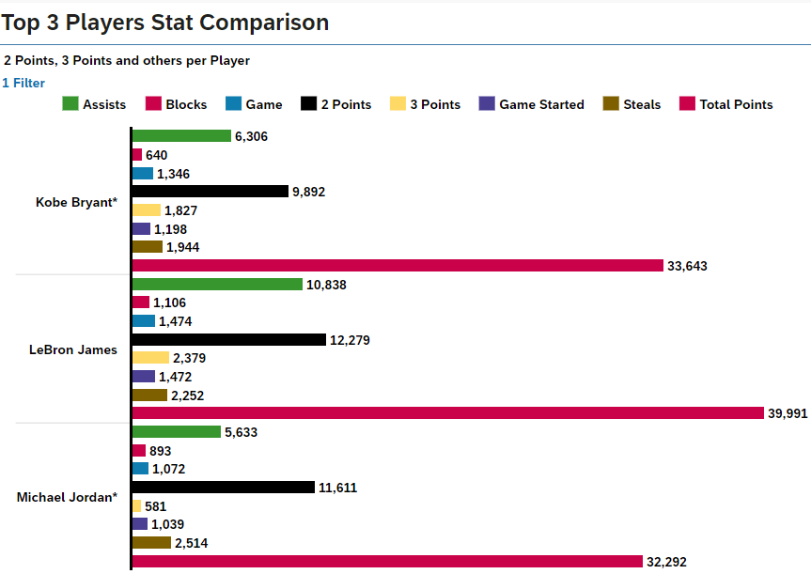
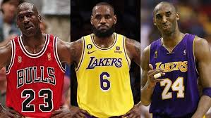
Top 3 candidates: comparison
Despite having a longer career and playing more games, Lebron James exceeds Kobe and Jordan in most stats
Average 27.13 pts per game across career
Only active player and will continue to grow stats
Notes:
Even if you are not an avid fan of the NBA, im sure that everyone in this room has heard of Lebron, Kobe, and Jordan. These three are most often in the GOAT comparison
Based on the stats in this slide, we see that Lebron leads in every category with the exception of steals (Jordan).
To comment on one stat specifically, Lebron's total points divided by his total games gives us a career average of 27.13 pts per game. Scoring 27 pts would be a career highlight for most of the NBA but for Lebron, this is an average night.
The final consideration as to why we feel Lebron is the GOAT is that he is the only active player of these three players and will only continue to increase his stats. At 39 years old, he has not showed any signs of slowing down

Slide 10
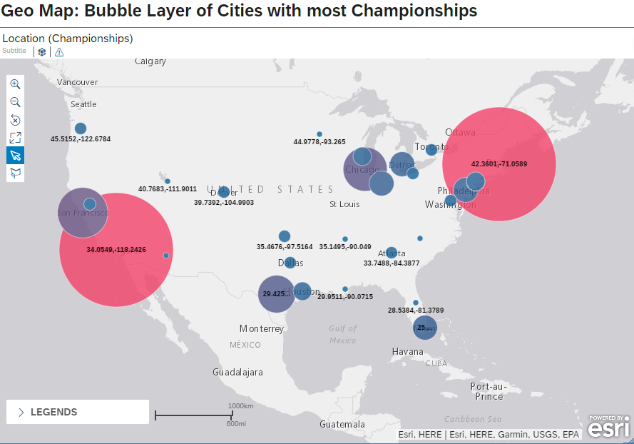
Total Championships by Geography
Leading NBA Championship Teams are the Los Angeles Lakers and Boston Celtics (17 each)
Teams with no championships and not on the map: Hornets, Grizzlies, Pelicans, Timberwolves, Magic, Suns, Jazz, and Clippers.
Notes:
For our Geo Map we showed a bubble concentration of every teams championships
We clearly see two concentrations which represent the Los Angeles Lakers and the Boston Celtics who are each tied with 17 championships
There are some other concentrations around San Francisco, Chicago, San Antonio, and Miami who have all had recent success in the last 15 years in winning championships
Currently there are 8 teams who have never won and are not on this map. They include the Hornets, Grizzlies, Pelicans, Timberwolves, Magic, Suns, Jazz, and Clippers

Slide 11
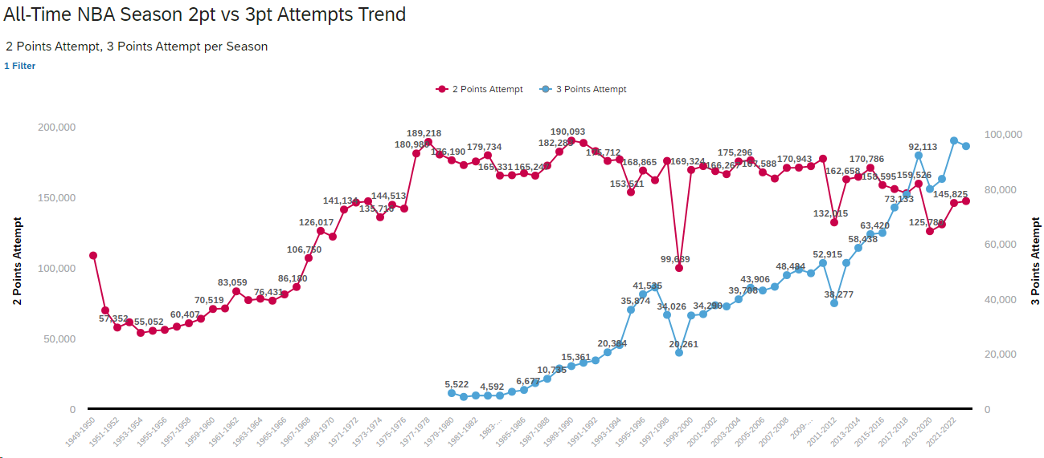
TRENDS: 3PT VS 2PT Attempts OUTLOOK FOR THE FUTURE
2 pt attempts vs 3 pt attempts, individual performance across players
Pre 1979 the 3 pointer did not exist
Since inception, the 3pt shot has gained in popularity and has surpassed 2pt attempts in 2018
Notes:
An interesting trend that has changed the game of basketball over the last few years is 2pt attempts vs 3pt attempts
The reason there is a gap in the graph is because the 3 pt shot did not exist before 1979. Since then it has had an upward trajectory and has surpassed 2pt attempts in 2018
One of the main reasons and influencers is Steph Curry who some regard as the greatest shooter of all time. Between 2014-2019, he and fellow splash brother Clay Thompson were the main contributors to this shift in the NBA
You may wonder why there are a few dips. These represent when the NBA was in a lockout between players and the owners

Slide 12
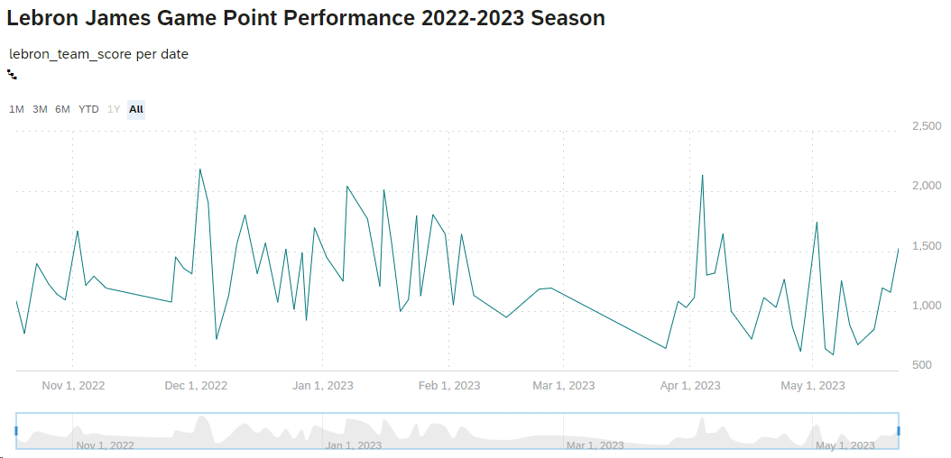
TIME SERIES Analysis: Lebron's season performance
Timespan of an NBA season from October to May
Slump in performance during March, but spikes back up as teams begin to compete for playoffs
Notes:
This is a time series analysis of Lebron's 22-23 season performance which spans from October to May
We see a strong start to the season which is typical since athletes are rested from the offseason
We then see a mid season slump which is common in many of the seasons that Lebron has played. Causes for this can included, burnout, injuries, and time load management
Performance will then usually spike back up in preparation for the playoffs which is normally where Lebron plays some of his best basketball allowing us to predict how well he is going to play in the playoff season.

Slide 13
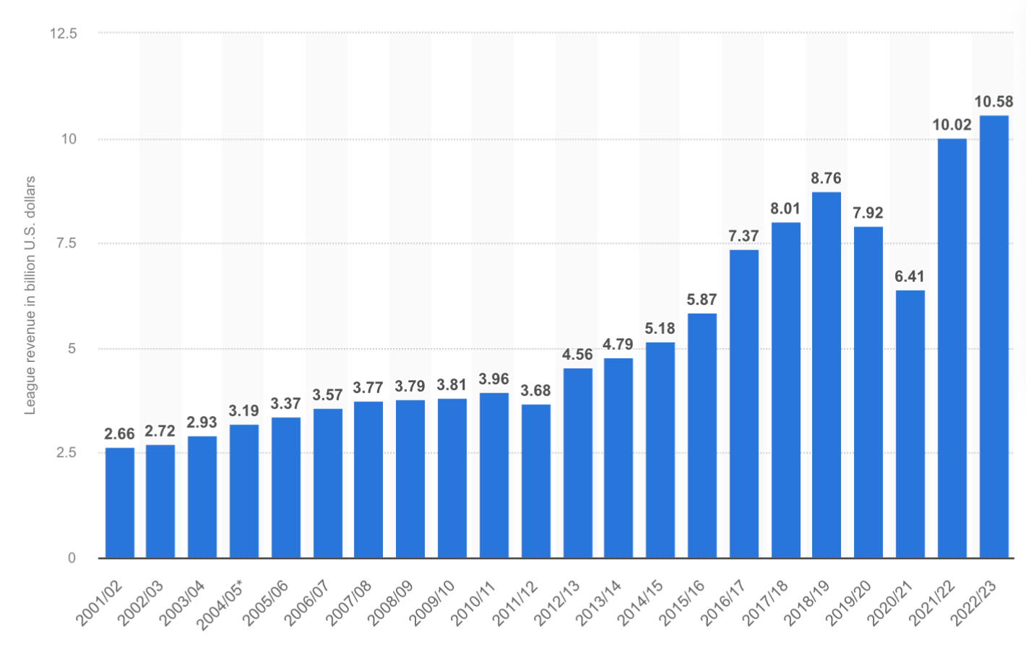
RELATED WORK COMPARISON NBA Revenue for 2022-2023
Notes:
https://www.statista.com/statistics/193467/total-league-revenue-of-the-nba-since-2005/

Slide 14
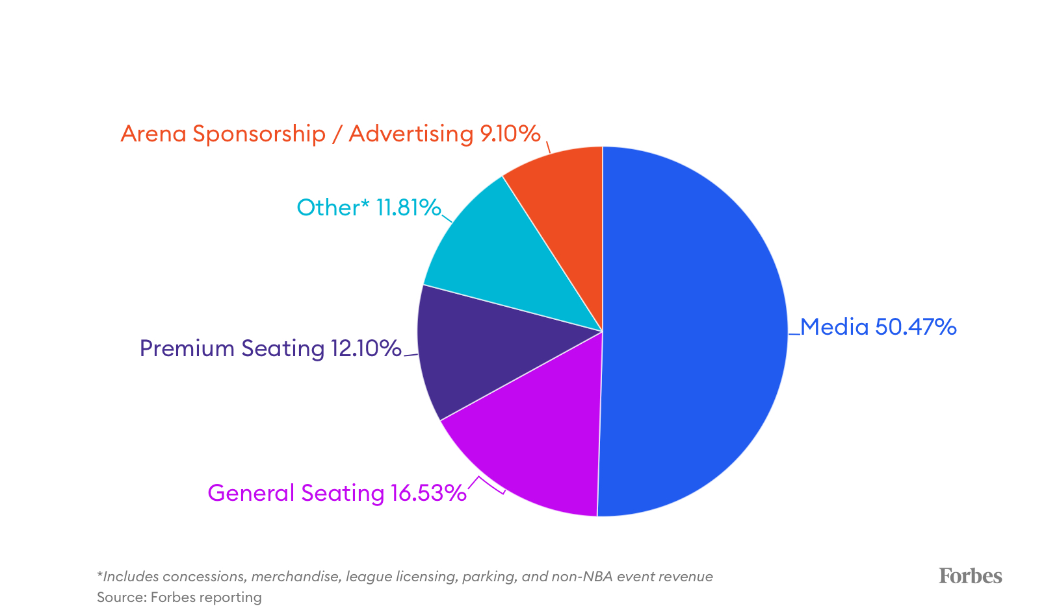
RELATED WORK COMPARISON NBA Revenue for 2022-2023
Notes:
https://www.forbes.com/sites/mikeozanian/2023/10/26/the-most-valuable-nba-teams-2023/?sh=6531450a209d

Slide 15
References
Ozanian, M. (2023, October 28). The most valuable NBA teams 2023. Forbes. https://www.forbes.com/sites/mikeozanian/2023/10/26/the-most-valuable-nba-teams-2023/?sh=6531450a209d Ozanian, M. (2023, October 28). The most valuable NBA teams 2023. Forbes. https://www.forbes.com/sites/mikeozanian/2023/10/26/the-most-valuable-nba-teams-2023/?sh=6531450a209d
Published by Statista Research Department, & 28, N. (2023, November 28). Total NBA League Revenue 2023. Statista. https://www.statista.com/statistics/193467/total-league-revenue-of-the-nba-since-2005/ Published by Statista Research Department, & 28, N. (2023, November 28). Total NBA League Revenue 2023. Statista. https://www.statista.com/statistics/193467/total-league-revenue-of-the-nba-since-2005/

